Slide 1

Plant health monitoring with photos based on Deep Learning
Course Tittle: Deep Learning
SUBMITTED BY | SUBMITTED TO
Md Akram Student id: 2210008 Hamm-Lippstadt University of Applied Science. | Prof. Dr. Achim Rettberg Hamm-Lippstadt University of Applied Science.

Slide 2





01
03
Monitoring Plants
Saving Time
Monitoring plant leaves to identify plant current health status.
Farmer can use my web app where they can see the health status of plants within few seconds.
Motivation
04
Increase Production & profit
02
Accurate Results
If farmer can identify disease within early stage then it very easy to control and it will save the cost of pesticide and it will increase the production.
I want to find out a state forward results like name of the infected diseases or healthy.

Slide 3
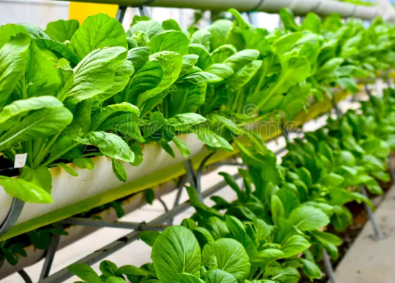
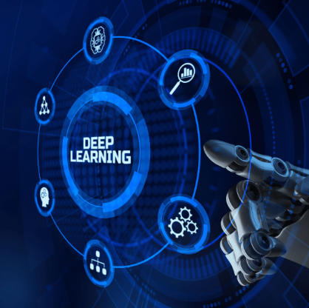
Plant Health & Deep Learning
Plant Health:
Refers to the condition of a plant including healthy or diseases affected.
Deep Learning:
A subset of machine learning that uses neural networks to automatically learn patterns from data

Slide 4


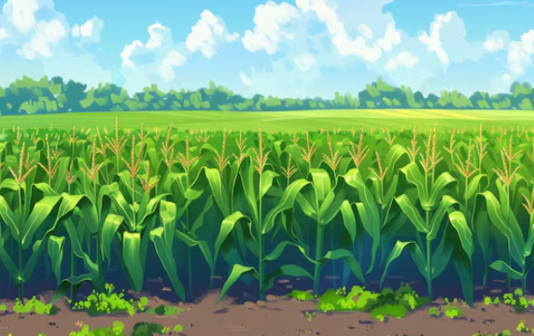


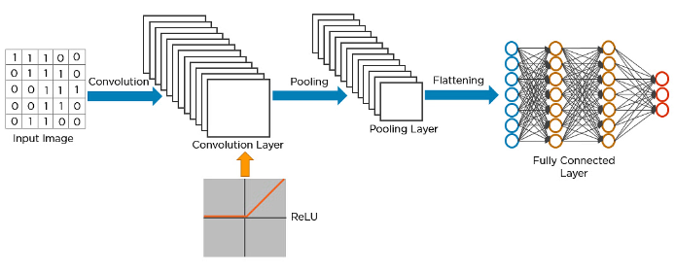
System Design
User interface layer
Dataset and Cloud layer
CNN Modelling and Training Layer

Slide 5
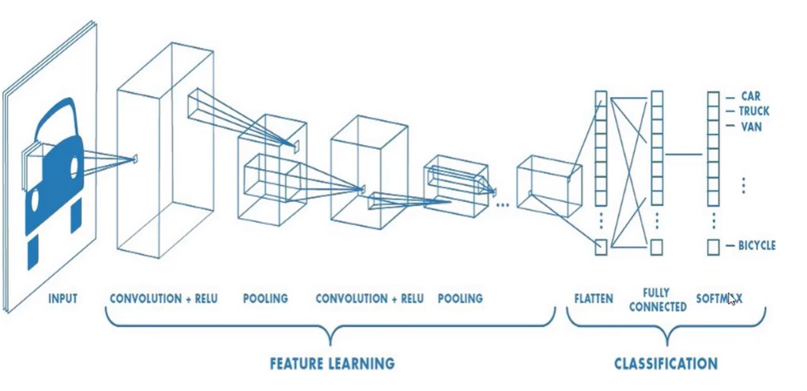
CNN Structure
CNN Structure Steps

Slide 6
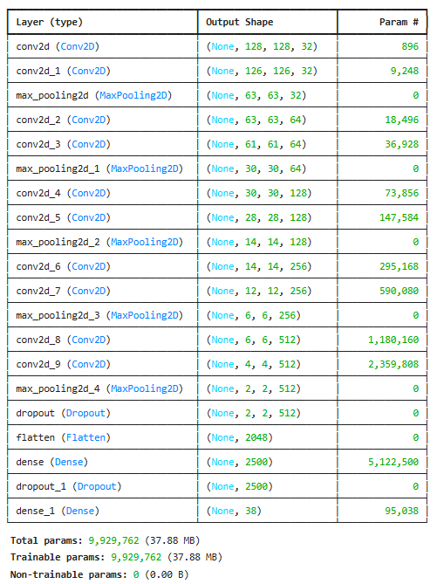
CNN Structure of My Model

Slide 7

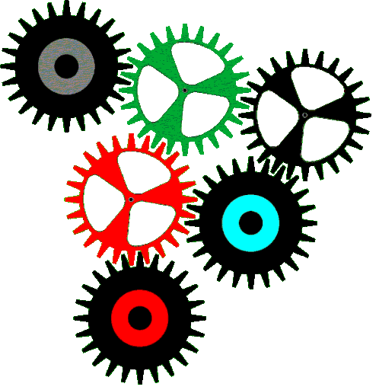
Dataset
Dataset Source
Kaggle
Dataset asset
14 Plants
38 Categories of disease
87.9K Training, Validation & Testing image
Available:
https://www.kaggle.com/datasets/vipoooool/new-plant-diseases-dataset/data

Slide 8
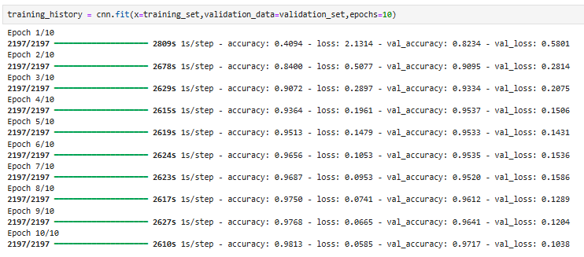
CNN Implementation
Used tools
Python
TensorFlow
Keras
Training Process
Separate directory for training and validation
Total 10 Epochs
After getting desire accuracy and losses stopped training
Training Epochs

Slide 9
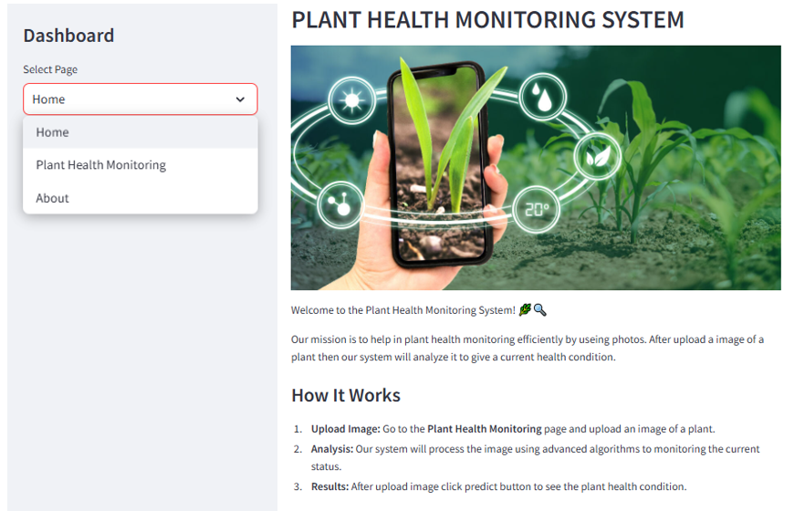
Web App Implementation
Used tools
Streamlit
Python
Trained Model
Benefits
Easy to Use
Real-Time Results
Free of Cost
Web App Interface

Slide 10
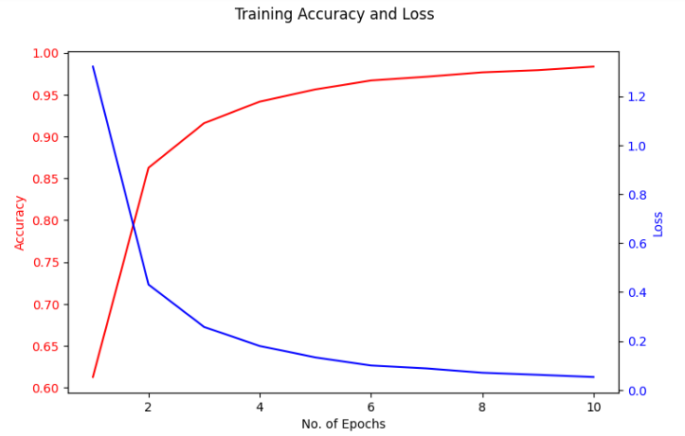
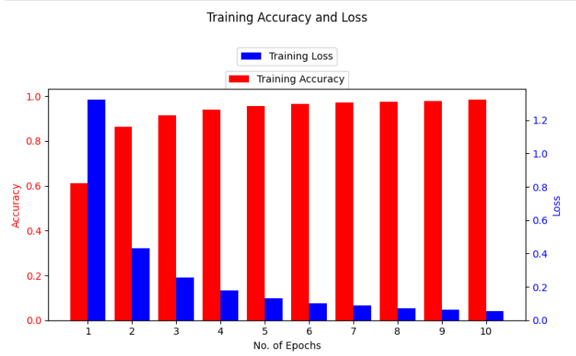
Experimental Evaluation
Training Accuracy and Loss

Slide 11
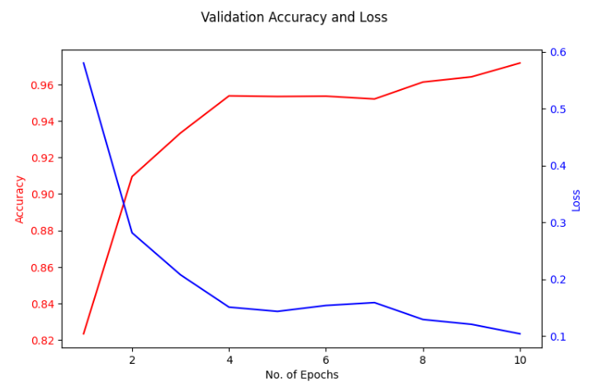
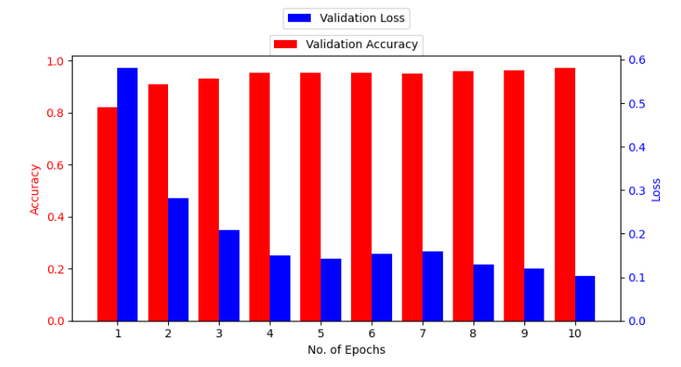
Experimental Evaluation
Validation Accuracy and Loss

Slide 12
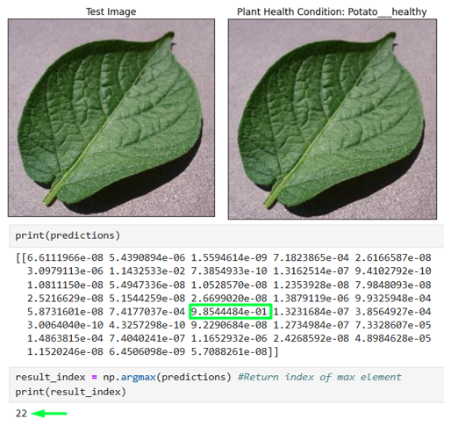
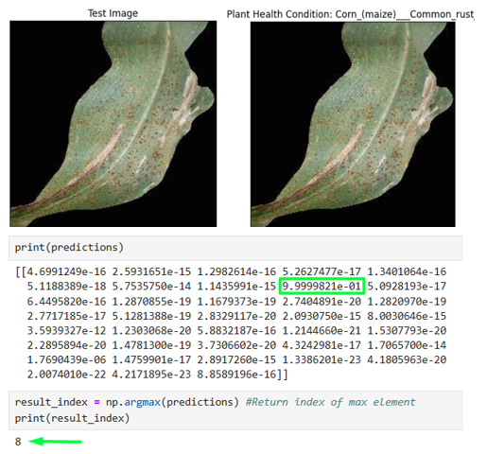
Experimental Evaluation
Model Prediction Results

Slide 13
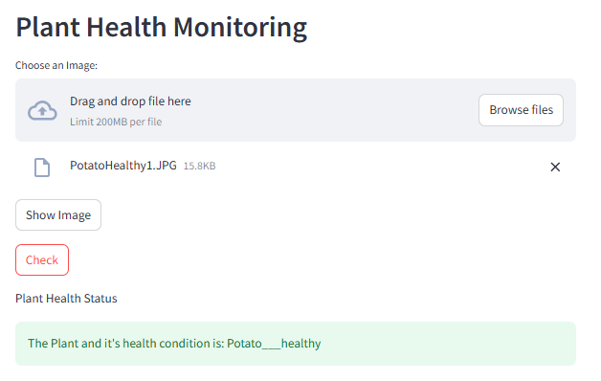
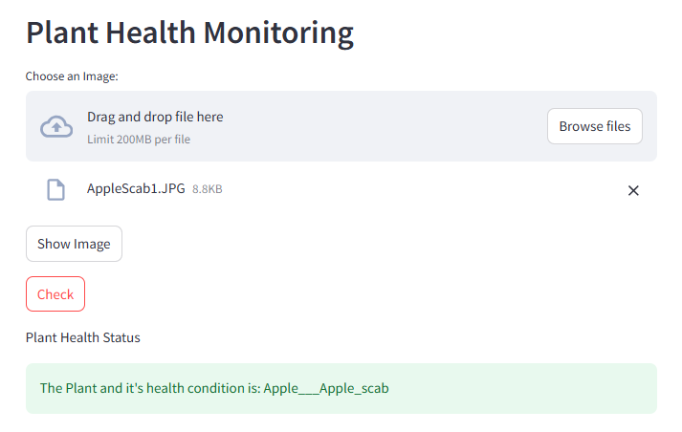
Experimental Evaluation
Web App Results

Slide 14
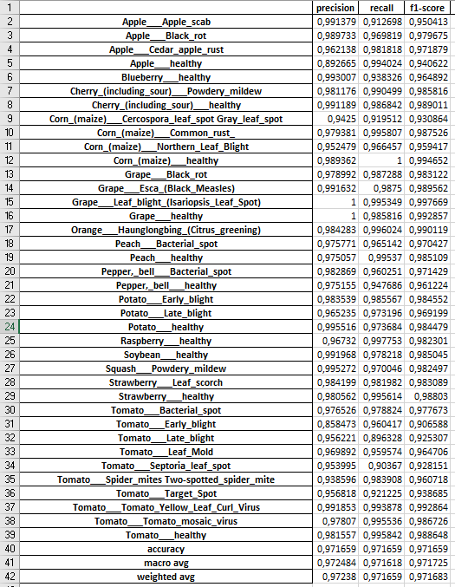
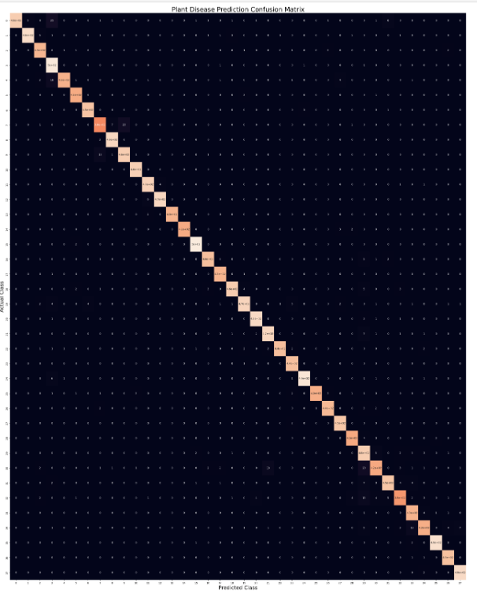
Experimental Evaluation
Precision, recall & f1-score
Confusion Matrix

Slide 15
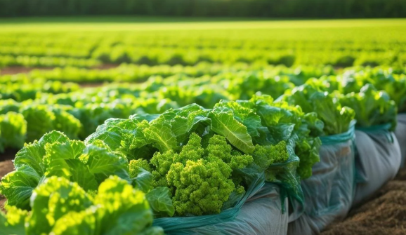
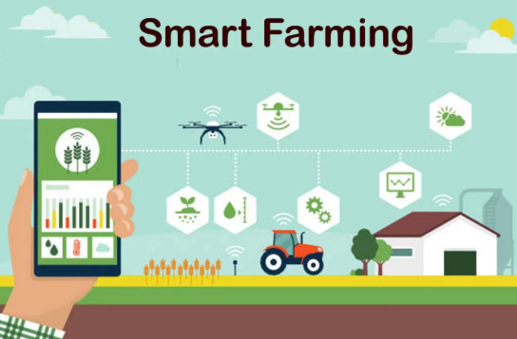
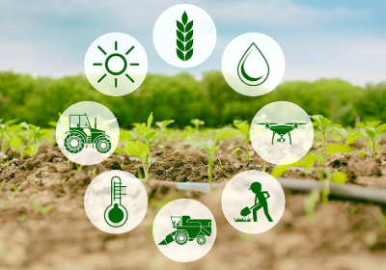
Conclusion & Future Work
The System can successfully Identifies plant health issues with high accuracy
It prove a user friendly interactive web app for farmer
The System saving time and Money as well as increase production.
In future I want to integrate real-time monitoring and IOT.

Slide 16

Do you have any question?

